Slide 1
Machine-Assisted Extraction of Formal Semantics from Domain Specific Semi-Formal Diagrams MOMACS 2019
Eric Davis, Alec Theriault,
Eddy Westbrook, Ryan Wright
This research was generously supported by the ASKE program under
DARPA-PA-18-02-AIE-FP-039

Slide 2
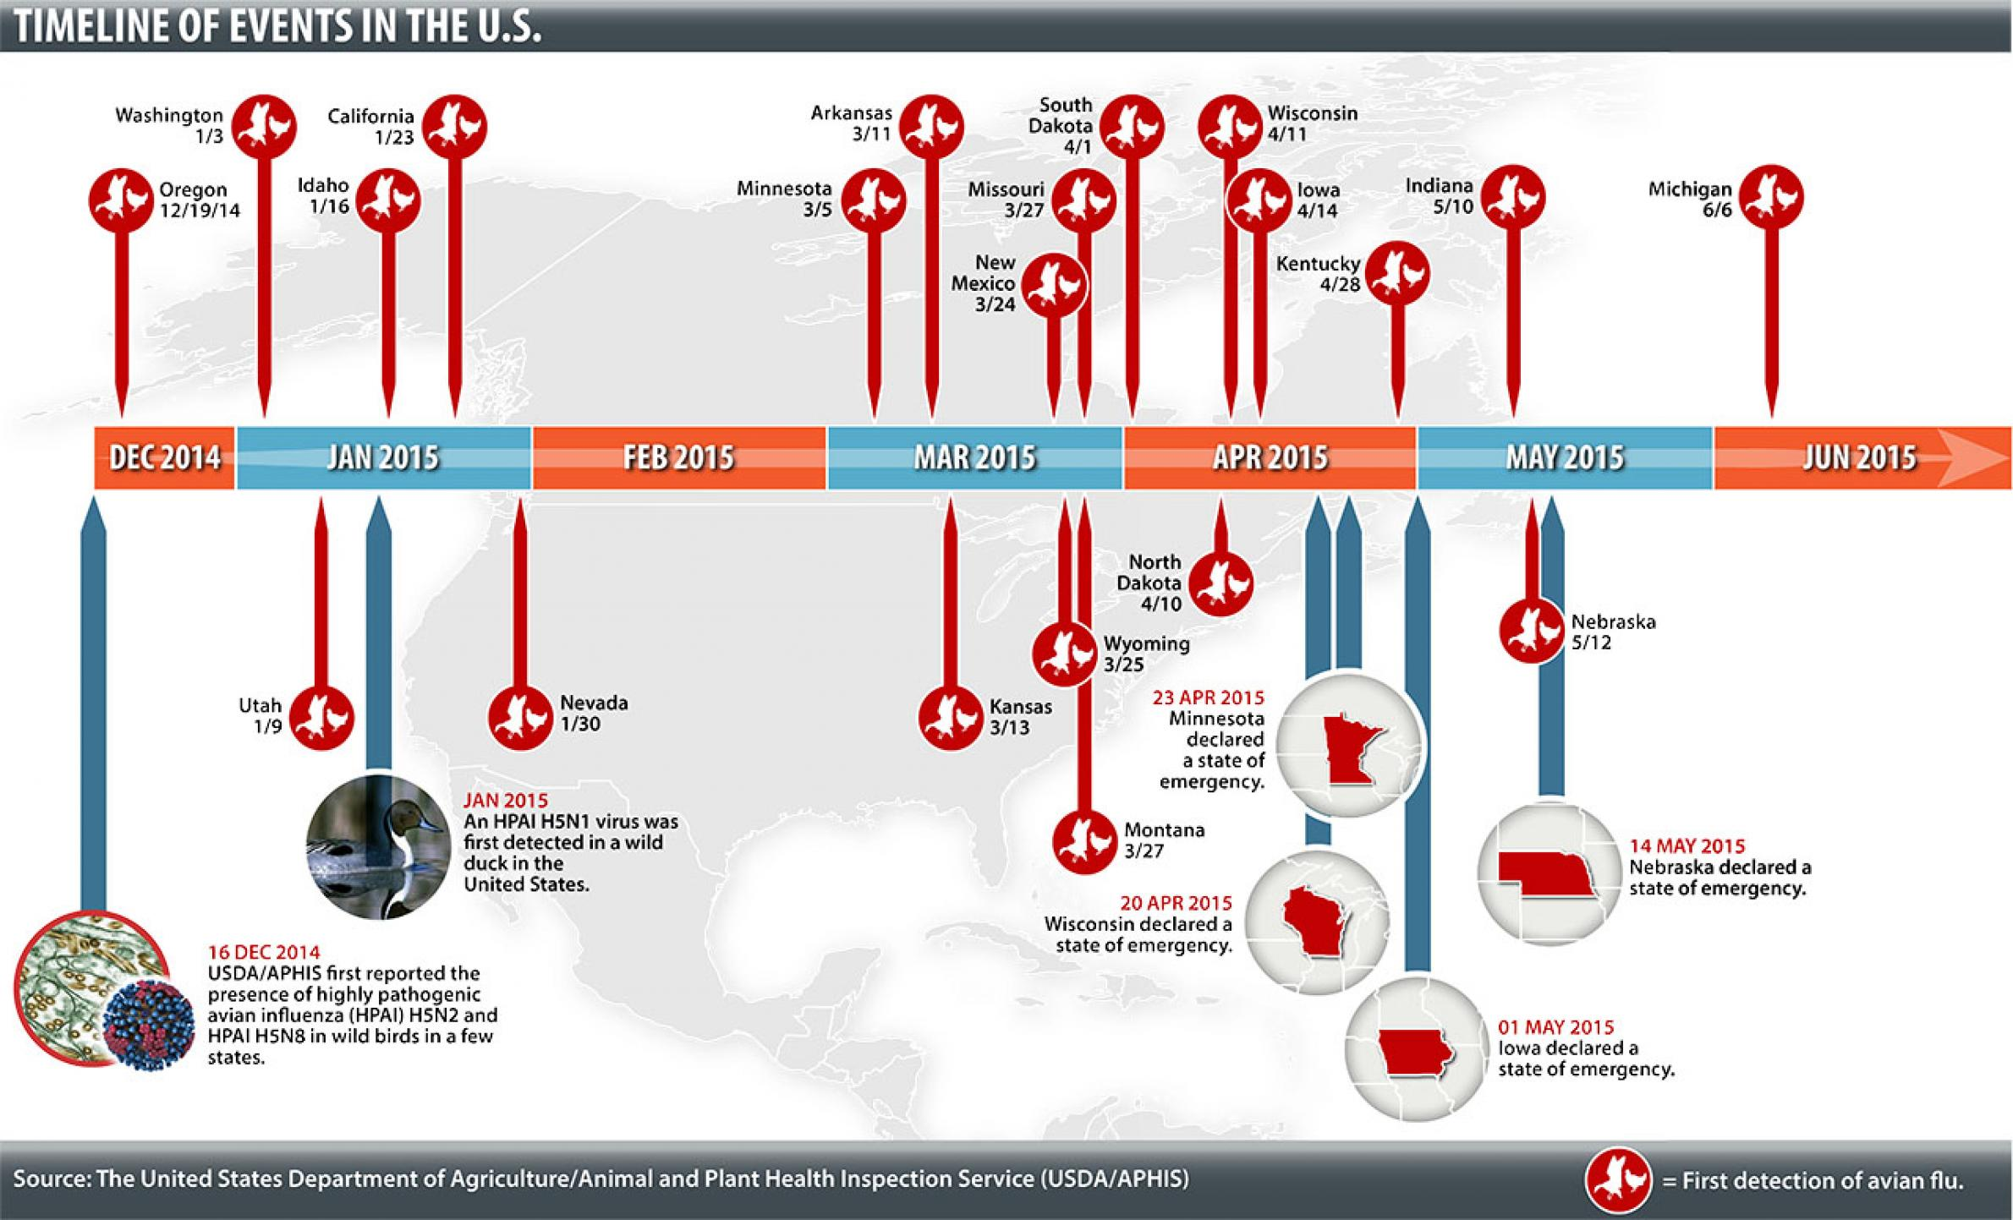
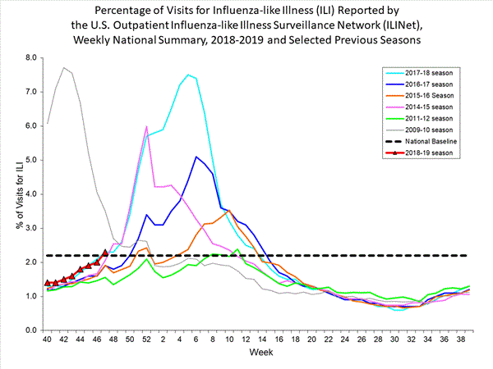
Modeling and Crisis Response: The Ideal
Domain experts capable of agile, performable, and high confidence modeling in response to crisis.
Leverage models to make decisions on actions, policy, with continuous improvement and feedback to improve outcomes.

Slide 3






Modeling and Crisis Response: The Reality
Building models of complex systems:
Requires large teams of modelers, mathematicians, and software engineers.
Not reusable.
Not maintainable.
Not easily developed.
Not performable.

Slide 4
Main Goals of AMIDOL
AMIDOL’s High Level Goals
Improve the ability of domain experts to build and maintain models.
Improve the explainability and agility of the results of machine-inference.
Lower the barrier for entry associated with formal languages.
Allow expression of rich mathematical concepts with visual diagrams.
Back visual diagrams with formal executable meaning.
Decouple model optimization, performance, and implementation from model definition.
Utilize performable, tested, back end solution methods.
Utilize a universal intermediate representation for easy translation and portability.

Slide 5
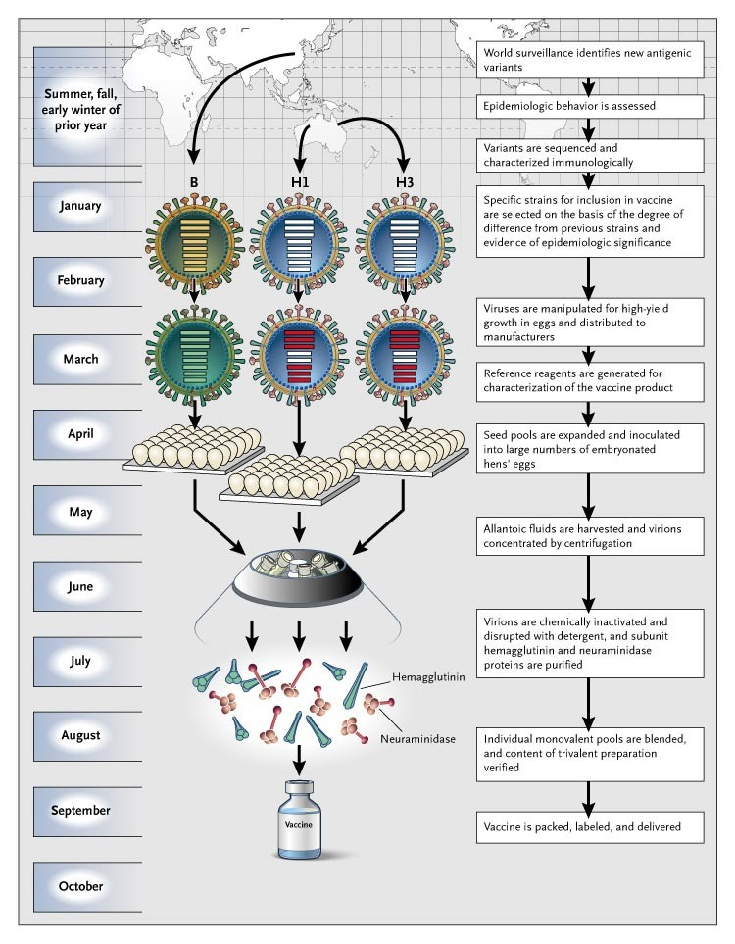
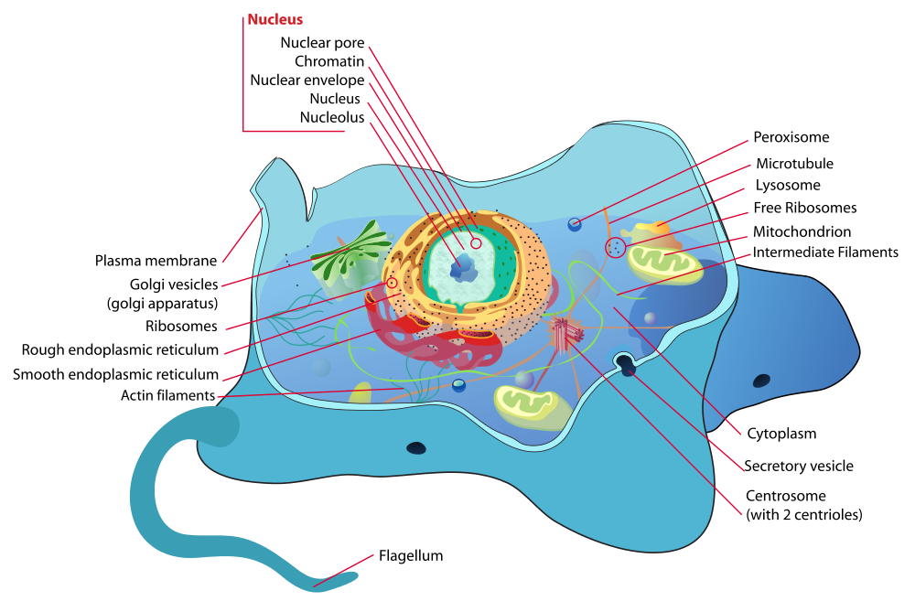
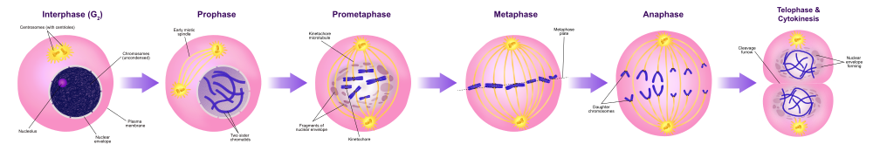
Semi-Formal Diagrams

Slide 6
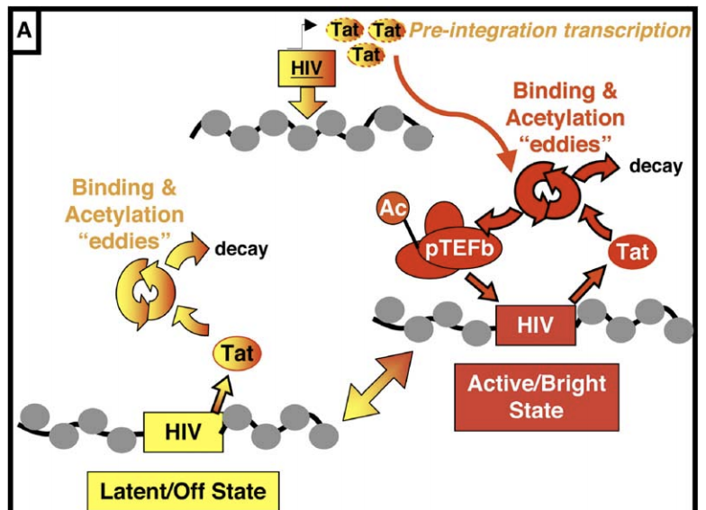
Tat Transactivation Model
Weinberger et al, “Stochastic Gene Expression in a Lentiviral Positive-Feedback Loop: HIV-1 Tat Fluctuations Drive Phenotypic Diversity“, Cell, 2005.

Slide 7
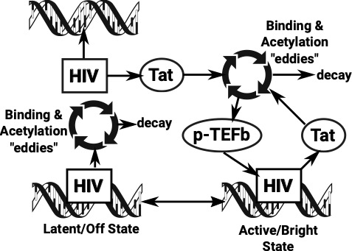
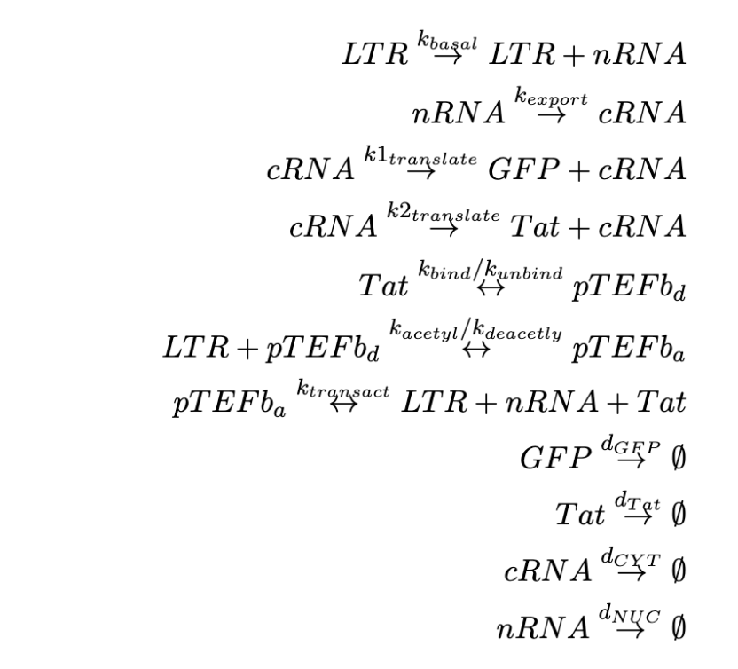
Tat Transactivation Model

Slide 8
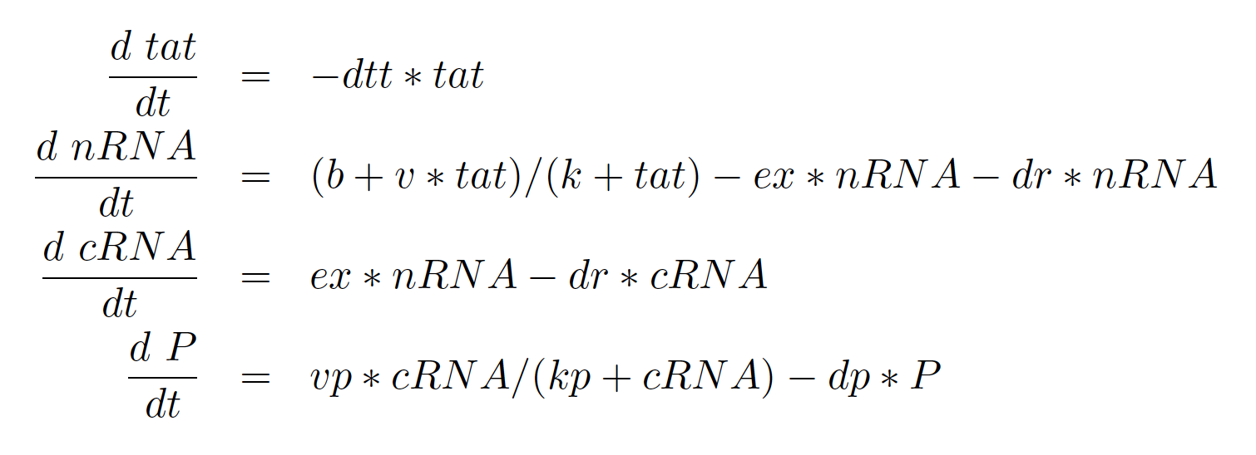
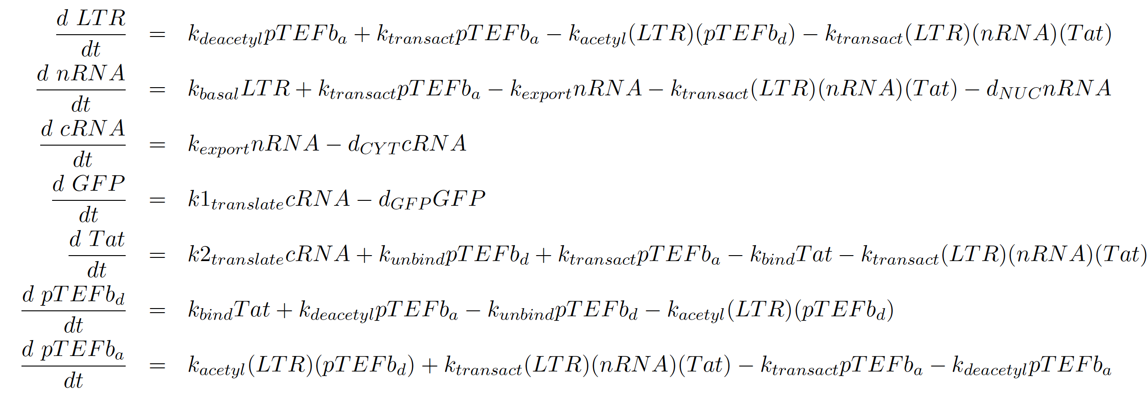
Tat Transactivation Model

Slide 9
AMIDOL Organization

Slide 10
AMIDOL Modeling Process

Slide 11




Visual Languages for Practitioners
Give mathematical meaning and executable syntax for diagrams.
Translate results back into explainable context.

Slide 12
Visual Domain Specific Ontological Languages

Slide 13
Abstract Intermediate Representation
Ground visual language in mathematical primitives in the form of an intermediate language.
Allows us to construct models from visual language.
Allows us to communicate results bound to mathematical constructs, using the visual ontology.

Slide 14
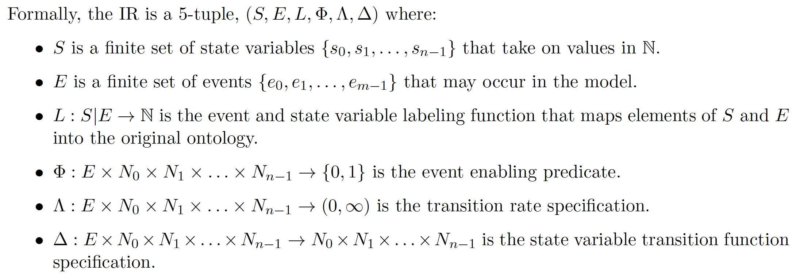
Abstract Intermediate Representation

Slide 15
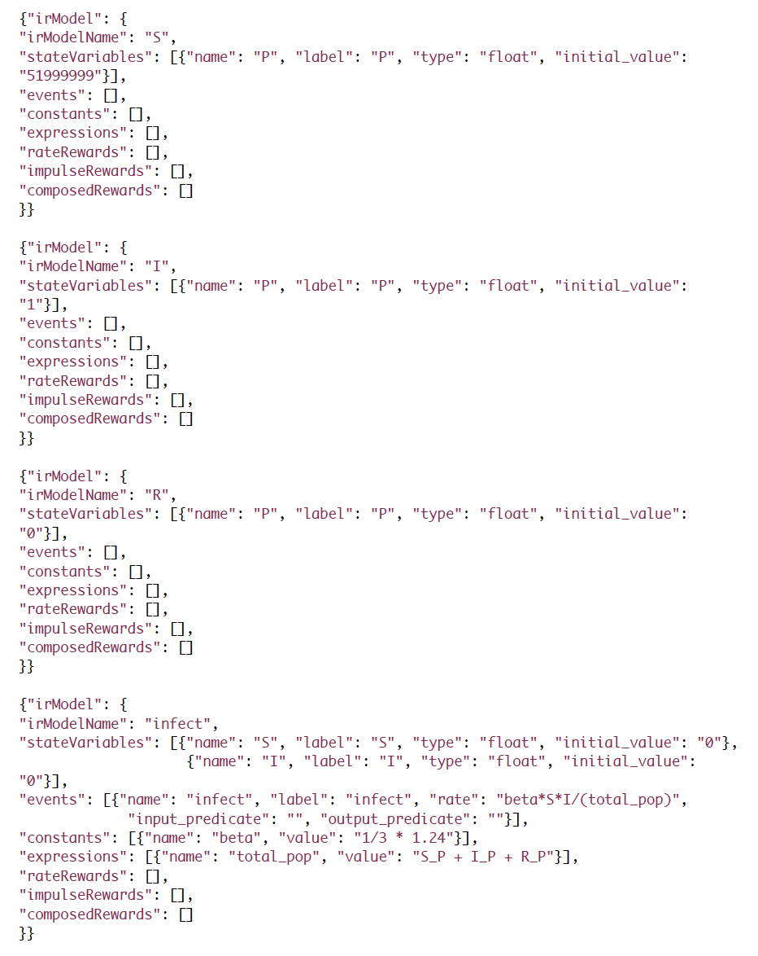
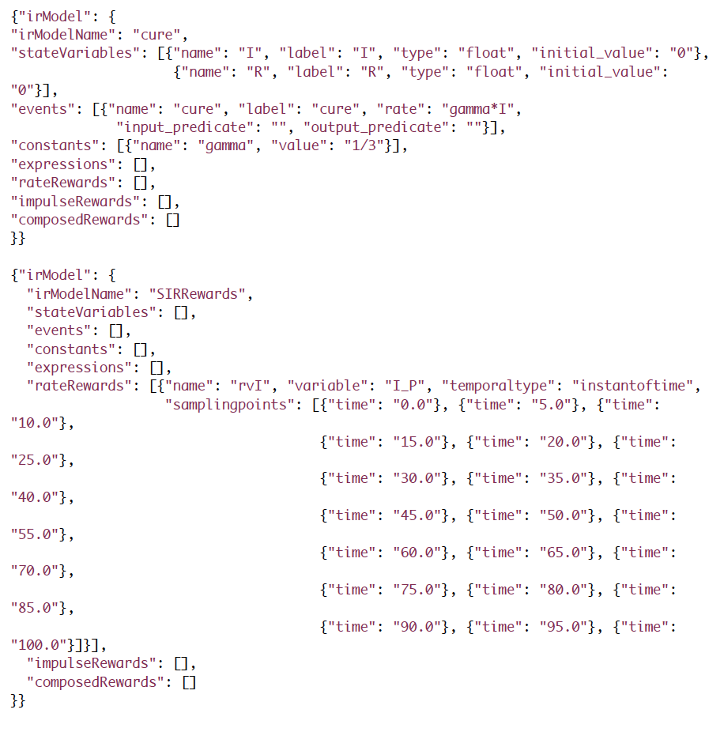
Abstract Intermediate Representation

Slide 16
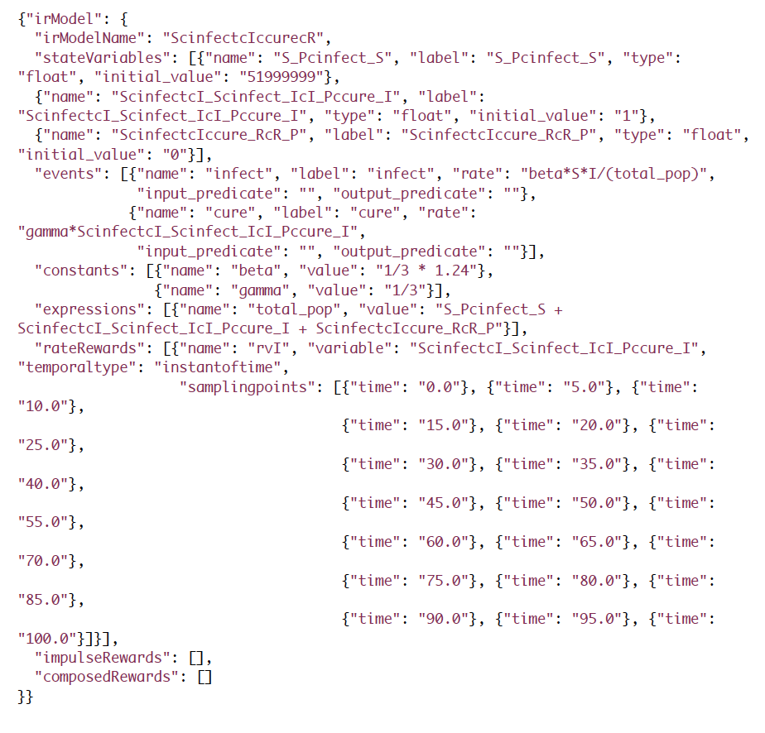
Abstract Intermediate Representation

Slide 17
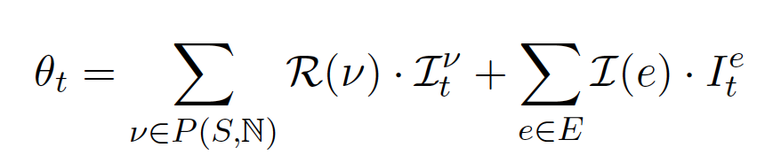
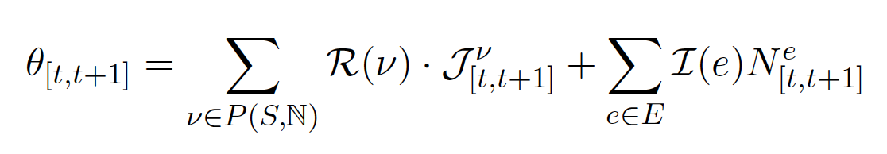
Reward Variables
Measure state variables and events over:
Instants of time
Intervals of time
Steady state
Results are stored in a database, with the model, and its parameterization for later comparison.

Slide 18
Putting it Together

Slide 19
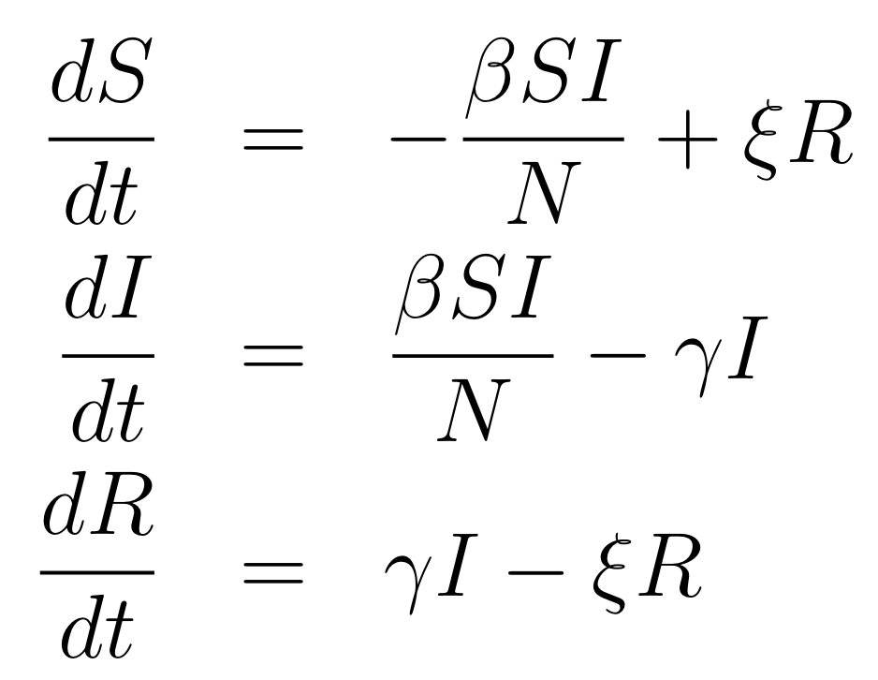
Putting it Together

Slide 20
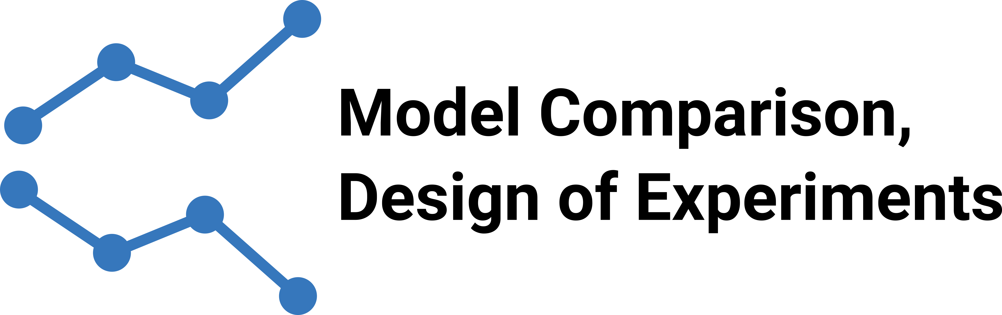
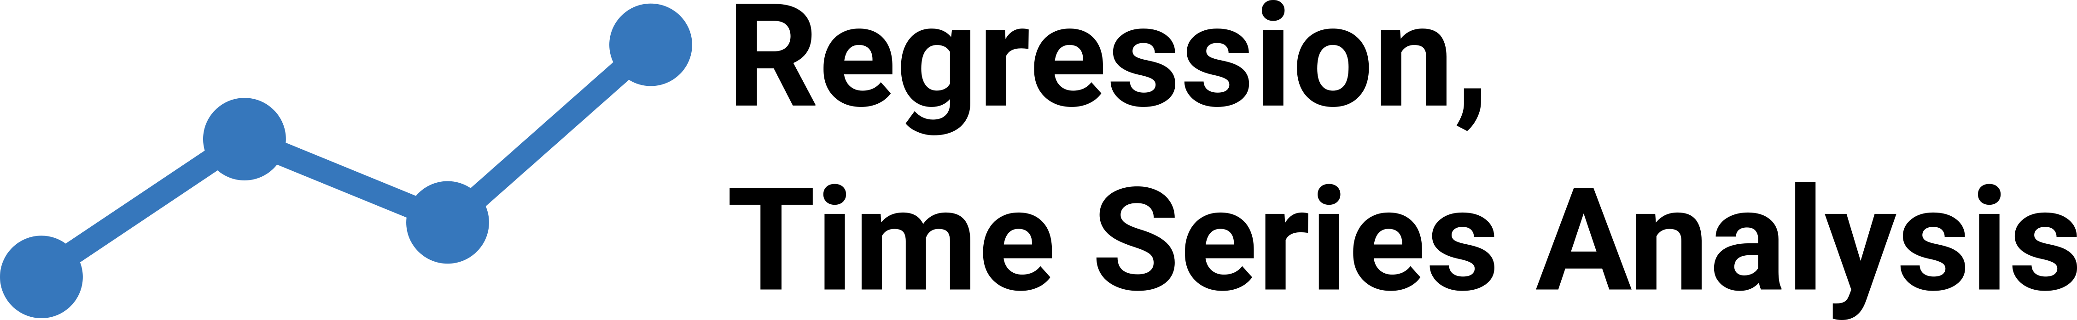

Interrogatability
Prediction
How will the system evolve in the near future?
Risk assessment:
What is the risk of X?
Conditional forecasting
How will the system respond if X changes?
Counterfactual analysis
What would have happened if X had been Y?
Comparative impact
What is the difference in utility between strategy X and strategy Y?
Optimal planning:
What is the optimal amount of X to introduce to maximize utility Y?
Risk assessment:
What is the risk of X?
Outcome avoidance:
What is the optimal action or intervention to reduce the risk of X decreasing more than Y?

Slide 21
AMIDOL Stack

Slide 22
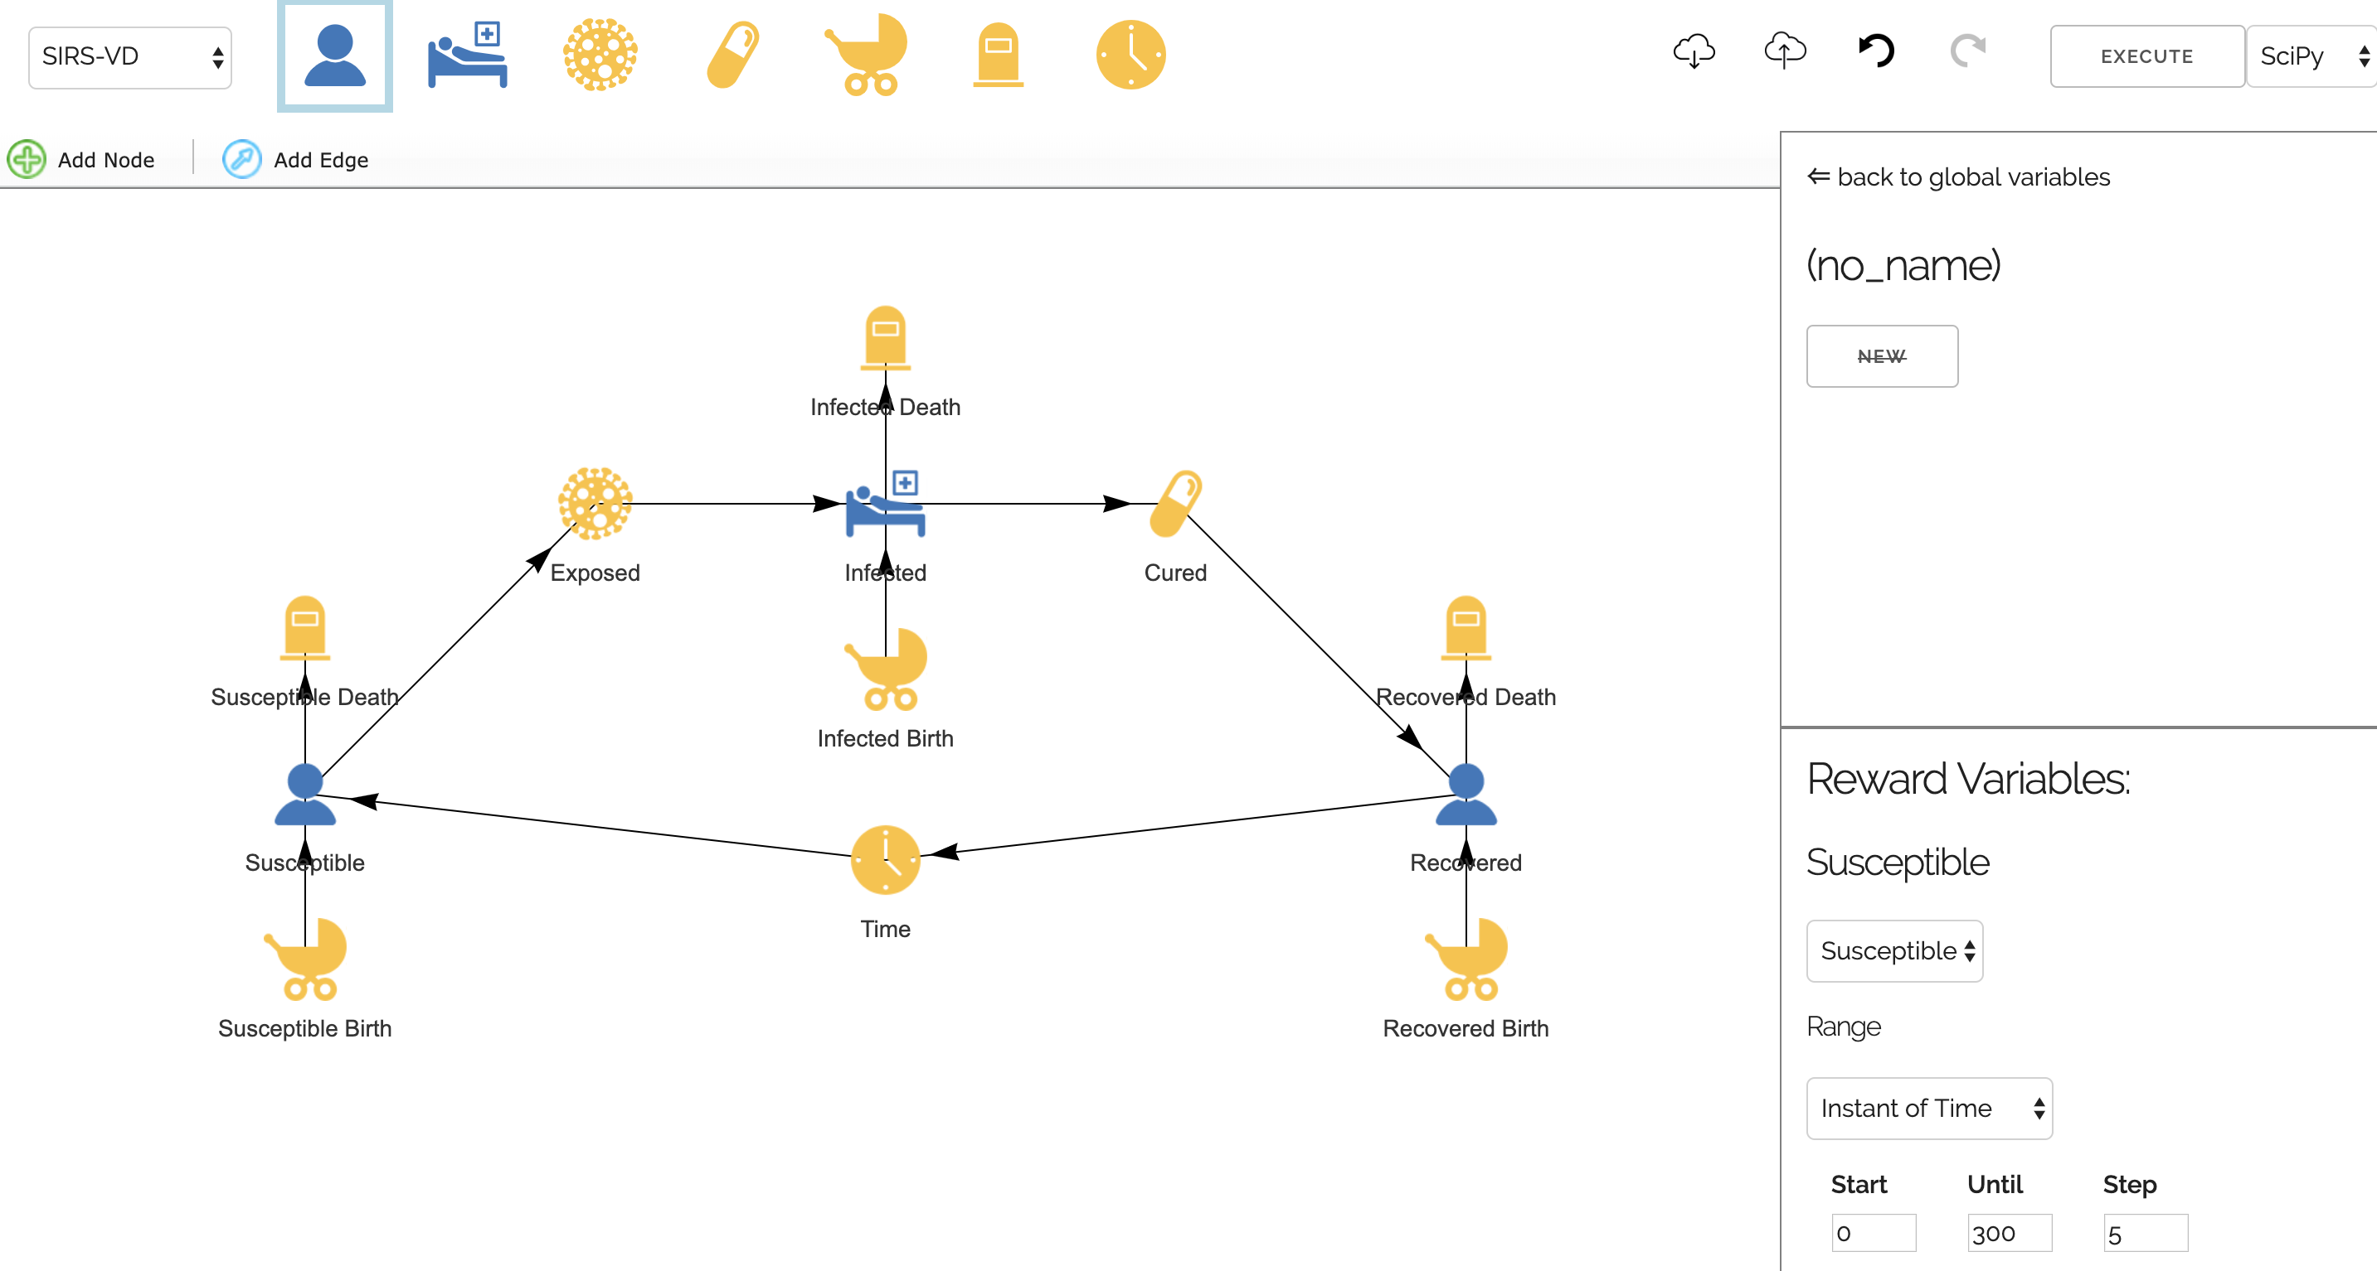
AMIDOL in Action

Slide 23
Challenges
Expressing complex concepts in visual formalisms requires thought.
Our VDSOLs allow for expressiveness, but it takes domain input to find the necessary metaphors.
Expressing reward variables is challenging.
How to find the right level of abstract vs. concrete?
Working on a good way to express design of experiments.
Interacting with TA1 performers
We can probably extract potential models, at least partially, in an automated fashion.

Slide 24

Thank you! Questions? ewdavis@galois.com
Notes:
Leaders in high assurance research and development
Creating trustworthiness in critical systems
Solving your hardest computer science problems

